Slide 1
10th Annual
University Conference on Teaching, Learning & Technology
Friday, May 13th 2016
“Learning as Social: “We participate, therefore we are.” – John Seely Brown

Slide 2

Breakfast & Coffee Break Sponsored by

Slide 3

Thank you for your support
Center for Innovative Teaching
CAPS - College of Advancing & Professional Studies
Healey Library
IT/Educational Technology
Office for Faculty Development
SHI – Software House International

Slide 4
Guest Wireless Access
Username: Spring2016
Password: Flowers9
Both username and password are case sensitive

Slide 5
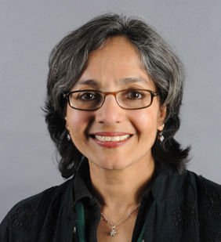
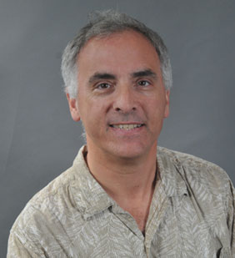
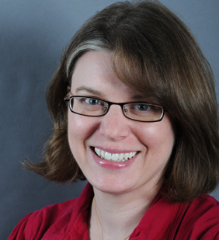
Speed Talks
“The Honors College: Innovation Incubator for Curriculum and Pedagogy”
Rajini Srikanth, Dean, Honors College
“Simulating Life: From Chemicals to Clownfish”
Brian White, Professor of Biology & Provost Fellow for Teaching
& Technology
“Making Synaptic and Social”
Susan Zup, Assistant Professor of Psychology

Slide 6

Twitter
Tweet using the #umbTLT (hashtag) during the conference
Some Helpful Tips:
Sign in to your account at Twitter.com
On the left sidebar on the homepage, enter your 140 characters in the “Compose new Tweet” box and end your tweet with the #umbTLT (hashtag)
During the conference, check your Twitter timeline to see and respond to attendee tweets and for conference updates
You can delete any of your tweets by going to your profile page, clicking on your tweet, and then the trash can button

Slide 7
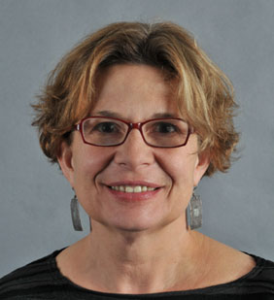
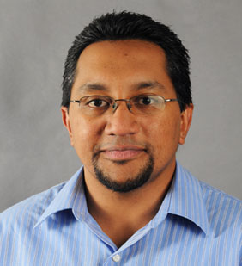
Teaching Innovation Award Face-to-Face
Winner – Shoshanna Ehrlich
Honorable Mention- Andrew Perumal

Slide 8
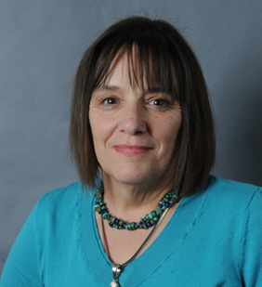
Teaching Innovation Award
Community Engaged
Honorable Mention
Amy den Ouden
Winner – Jacqueline Lageson

Slide 9
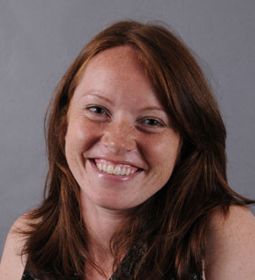
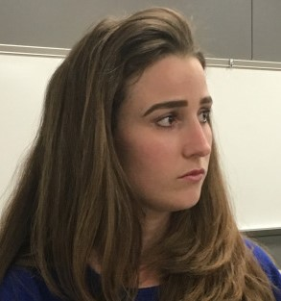
Teaching Innovation Award Online
Winner – Laura Hayden
Honorable Mention – Ashleigh Shelton

Slide 10
Thank You to the Conference Committee
Prof. Ping-Ann Addo – Director, Center for Innovative Teaching
Prof. Judith Goleman – Director, Office for Faculty Development
Prof. Brian White – Biology & Provost Fellow for Teaching & Tech
Daniel Ortiz – Dean of University Libraries
Wendy Shapiro – Assoc. Dean of Learning, Design & Tech - CAPS
Camille Martinez – Assistant Director, OFD
Teresa Maceira – Reference Librarian – Healey Library
Jason Campos – Manager, Online Education - CAPS
Gene Shwalb – Manager, eLearning & Instructional Support - IT
Apurva Mehta (Chair) – Associate CIO - IT

