Slide 1
Portfolio Tutorial
Blackboard Learn

Slide 2
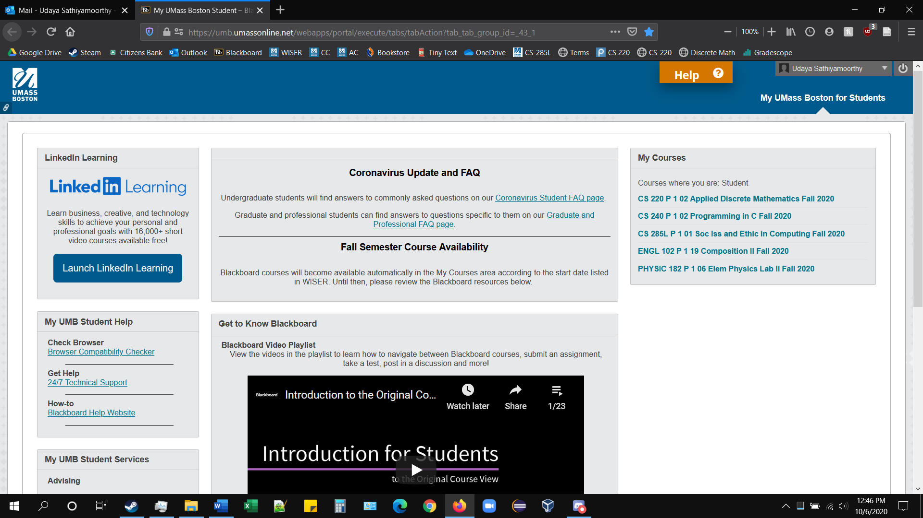
Click on the Global Navigation Menu.

Slide 3
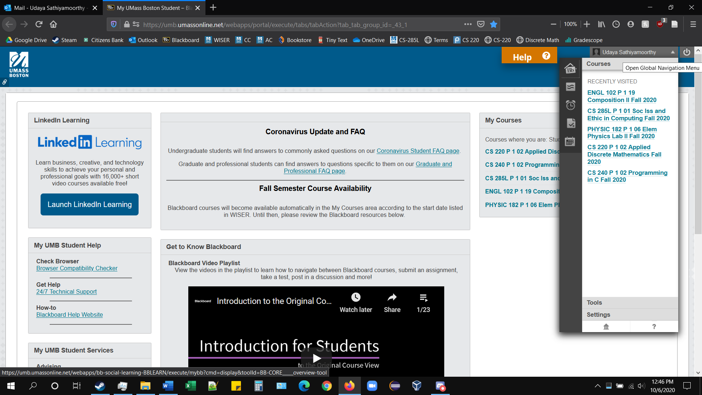
Click on “Tools.”

Slide 4
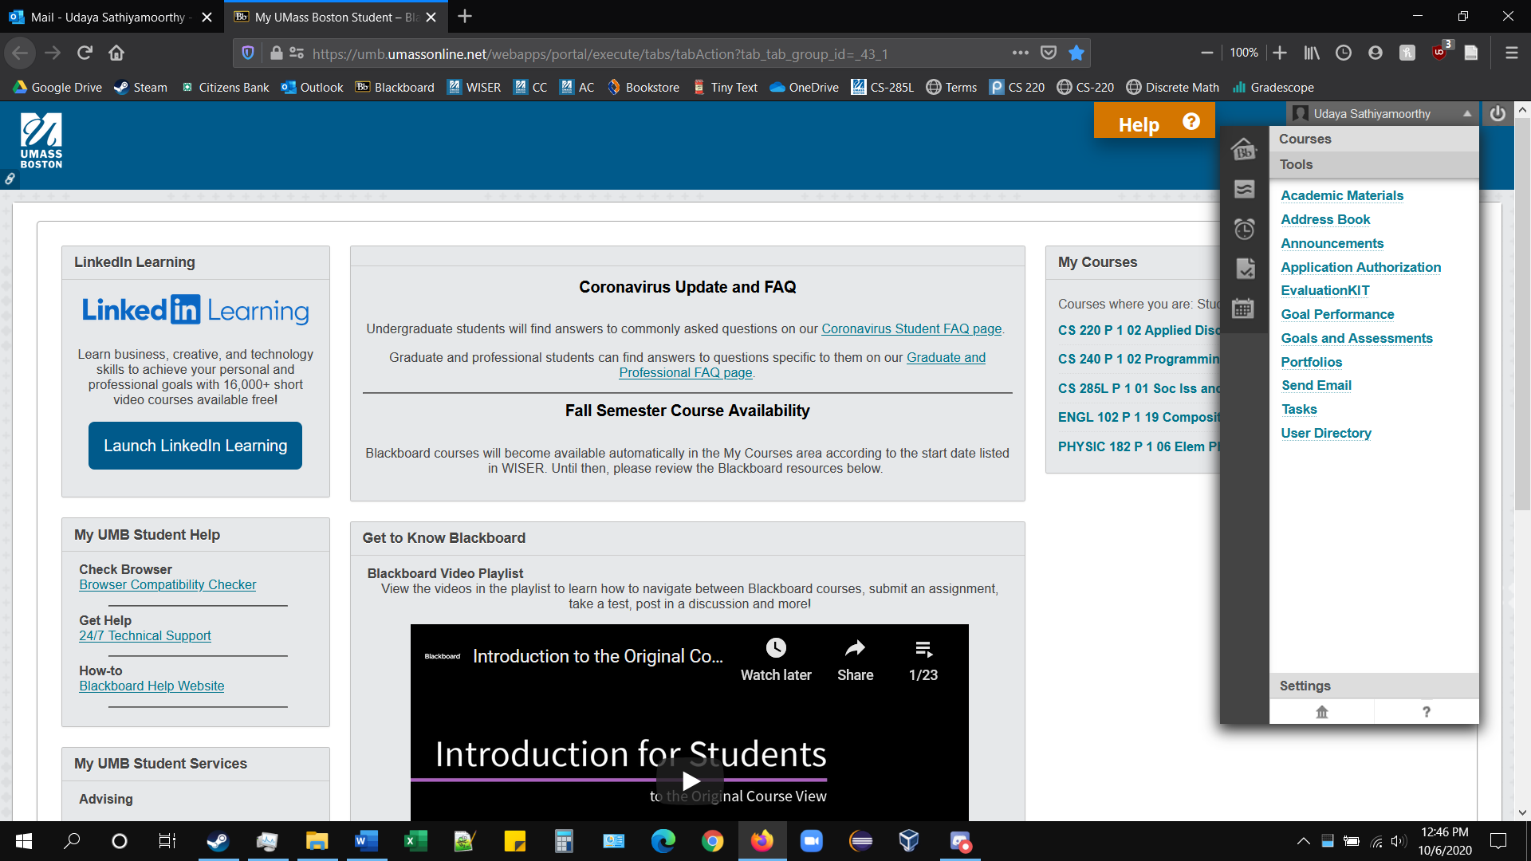
Click on “Portfolios.”

Slide 5
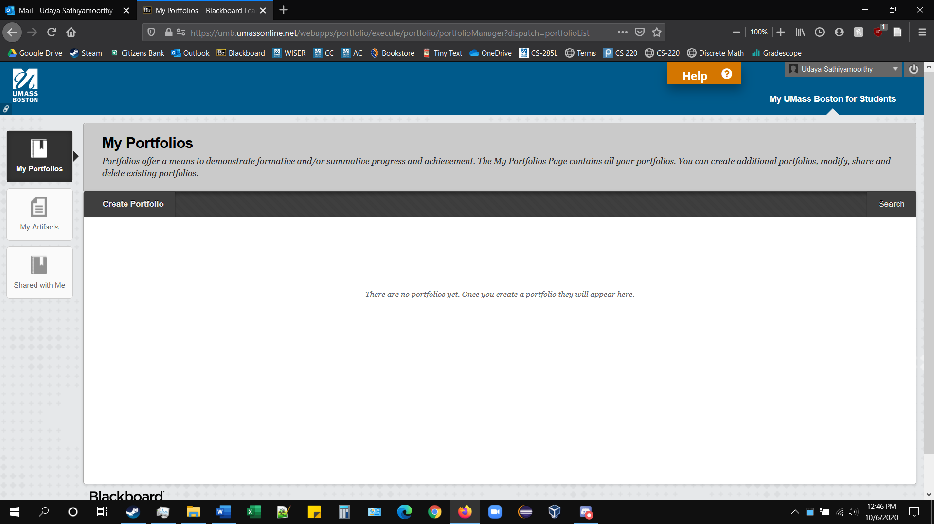
Select “My Artifacts.”

Slide 6
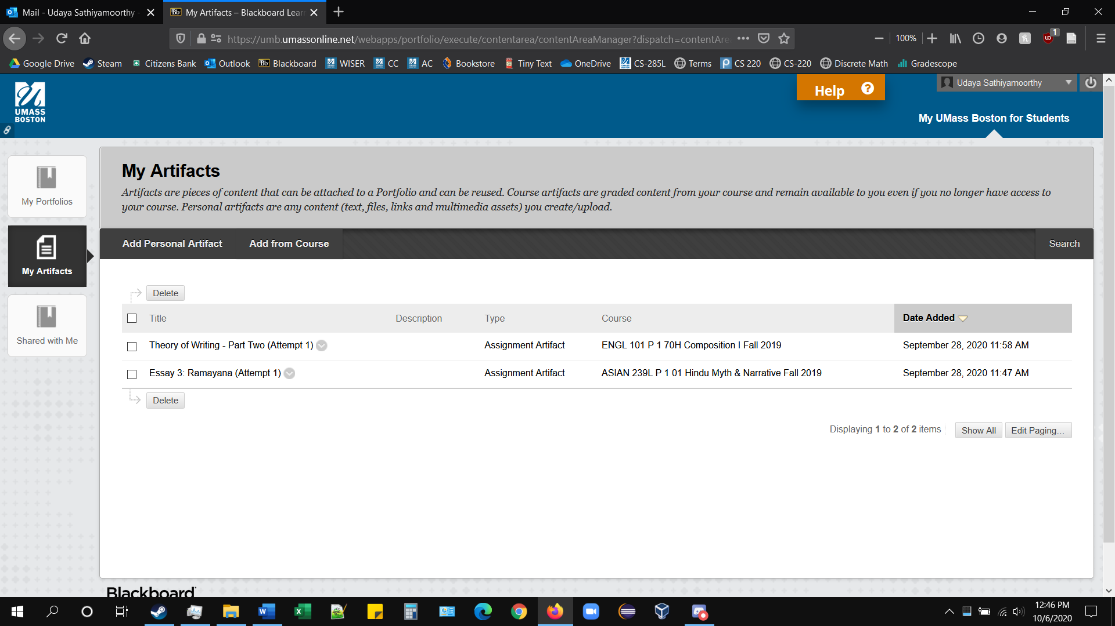
Select “Add from Course.”

Slide 7
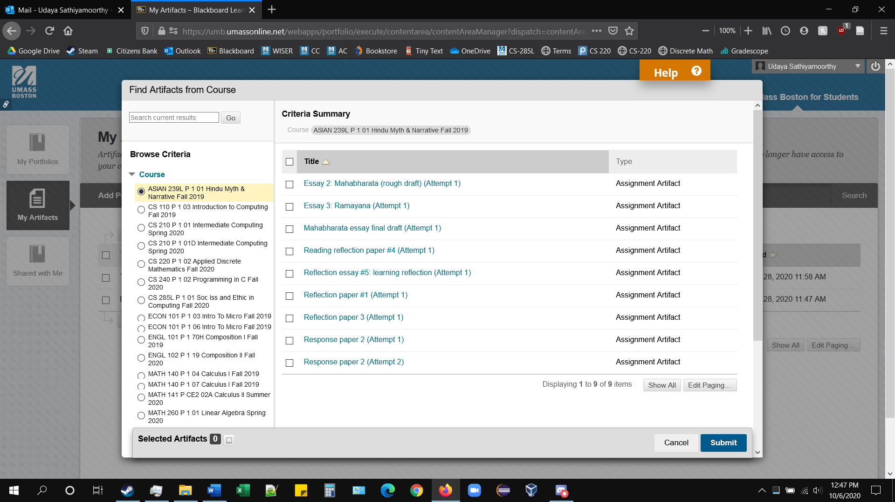
Here you can view all attempted submissions from both your current and previous classes.

Slide 8
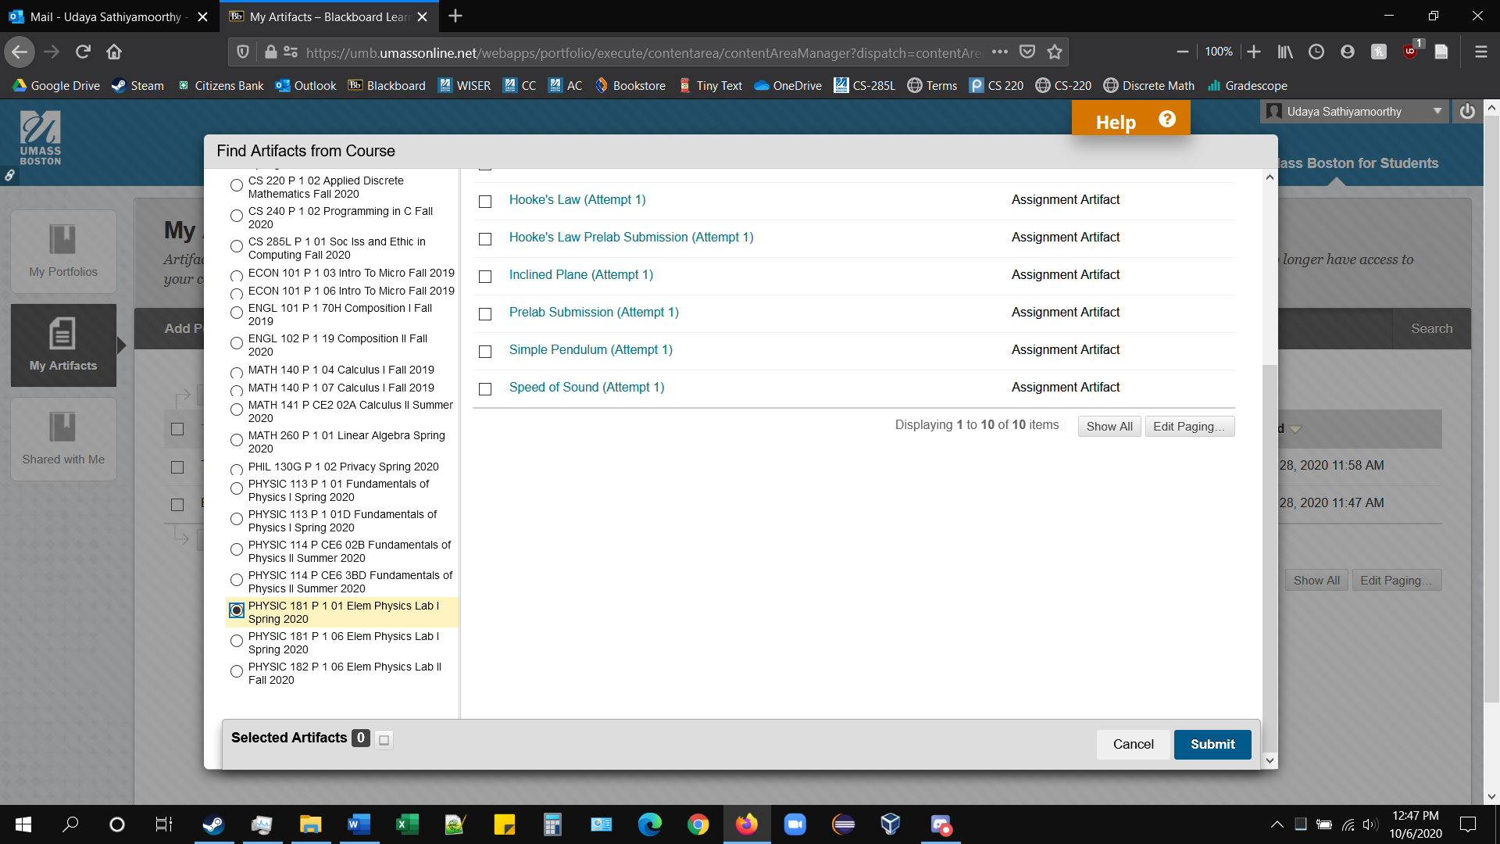
Select the class you want to view submissions from.

Slide 9
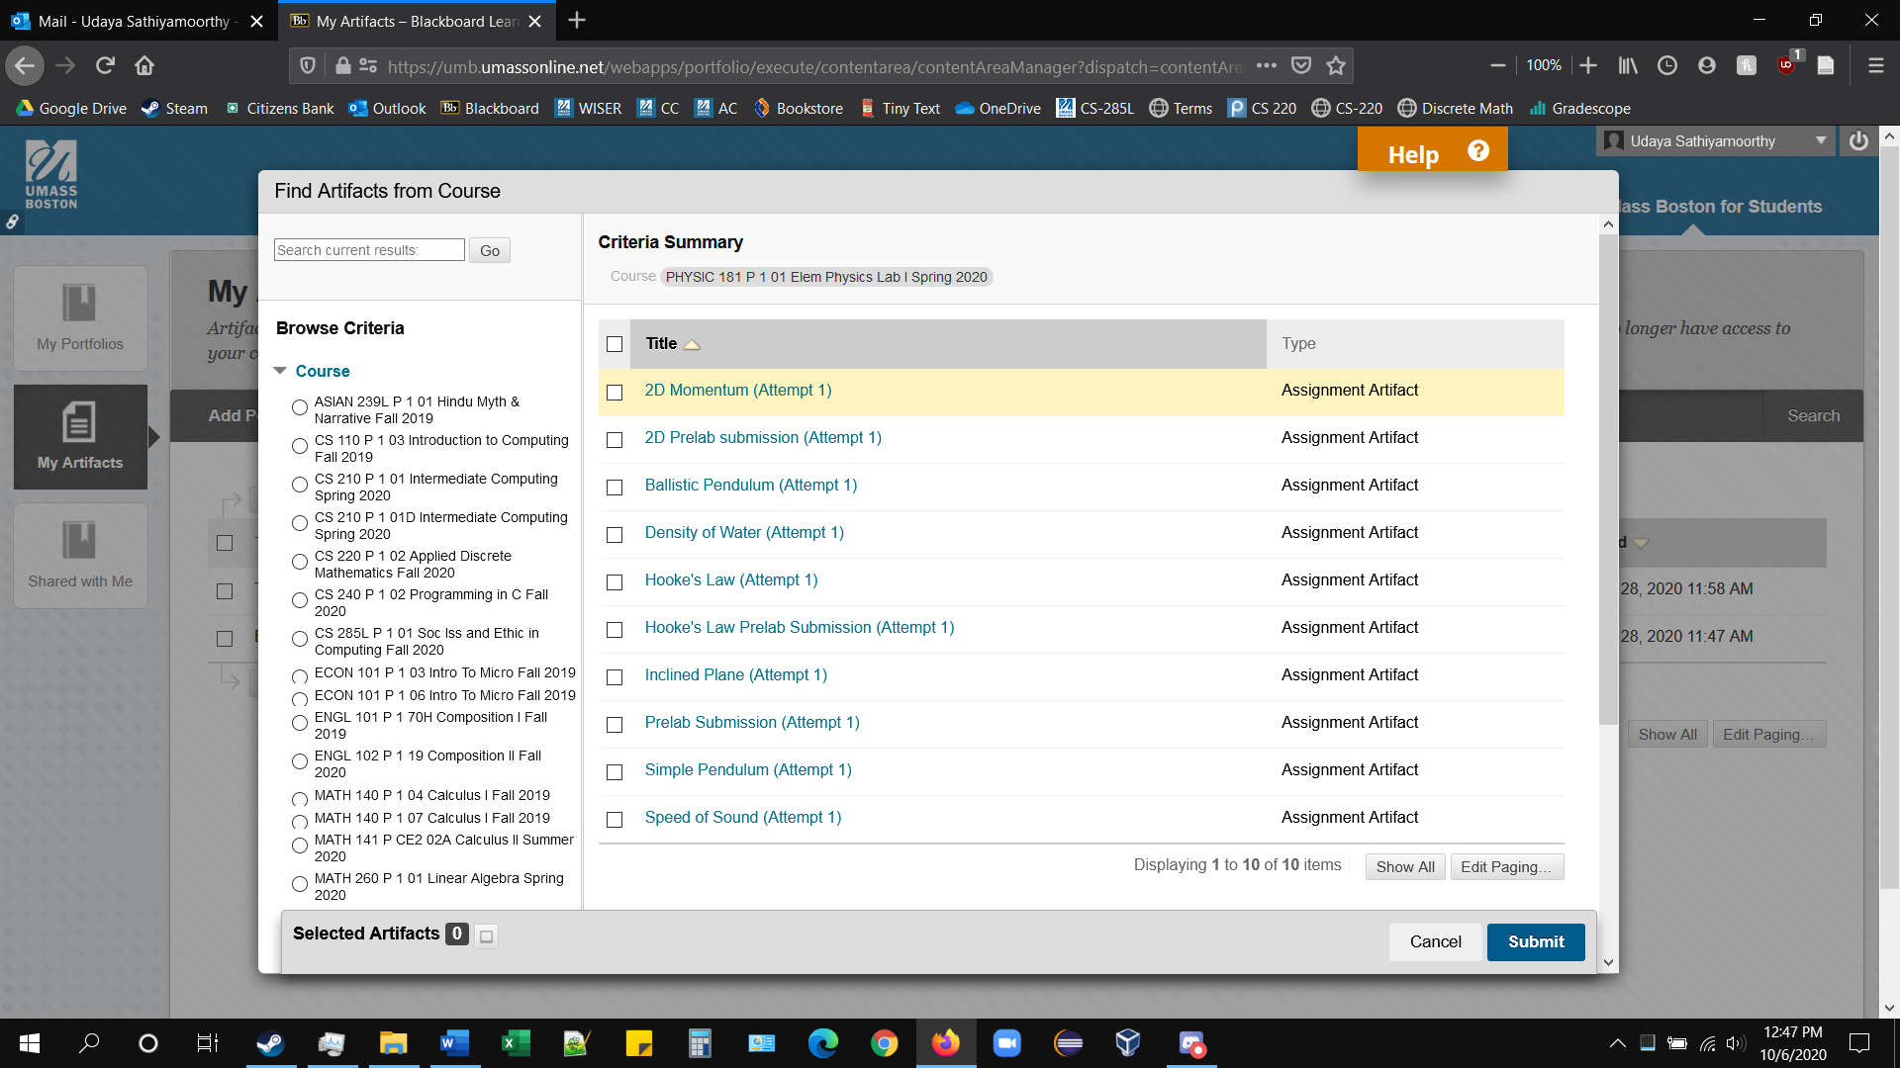
Click on the name of the submission to view it.

Slide 10
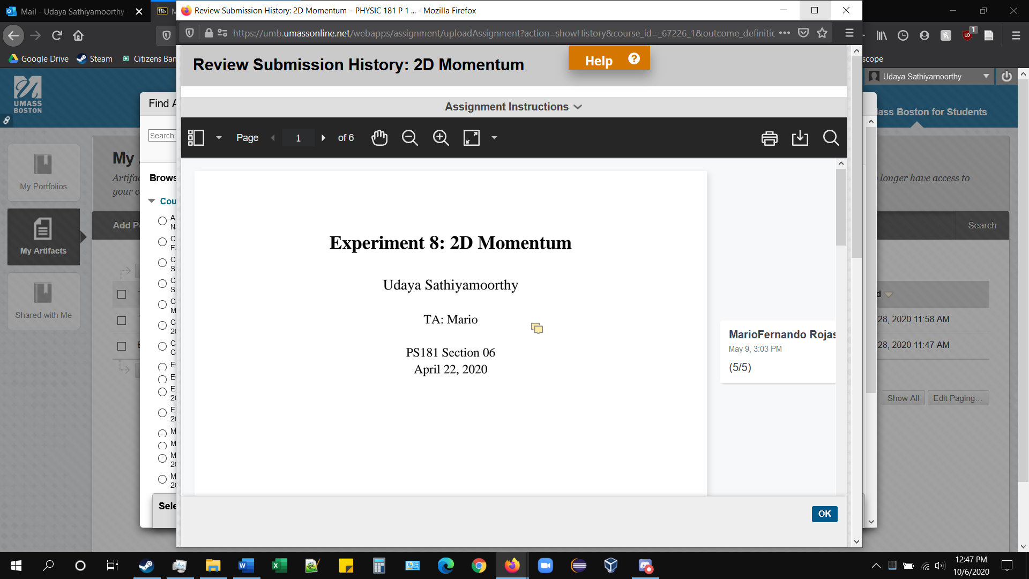
A separate window will pop up, showing the submission.

Slide 11
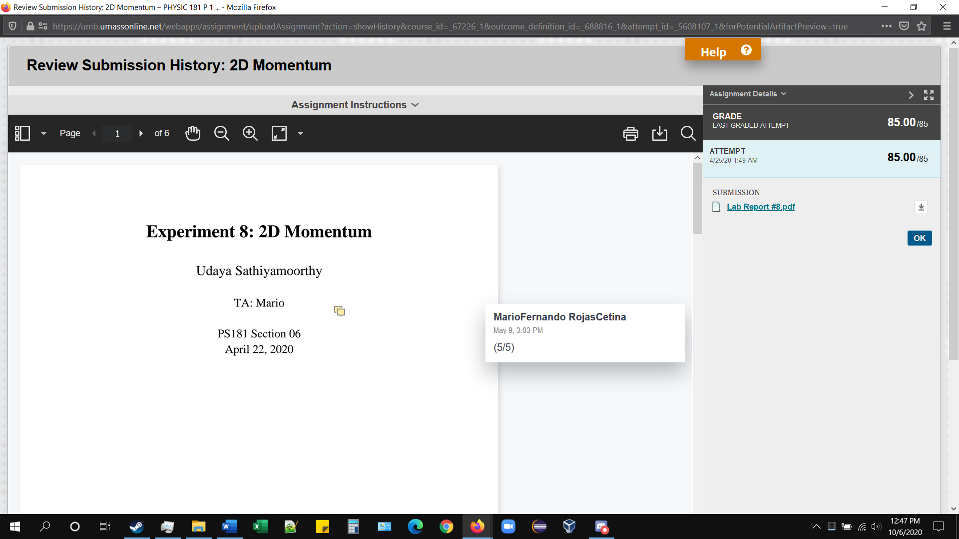
Maximize the window, and you can see the comments, grading, and submitted attachments for the assignment.

Slide 12
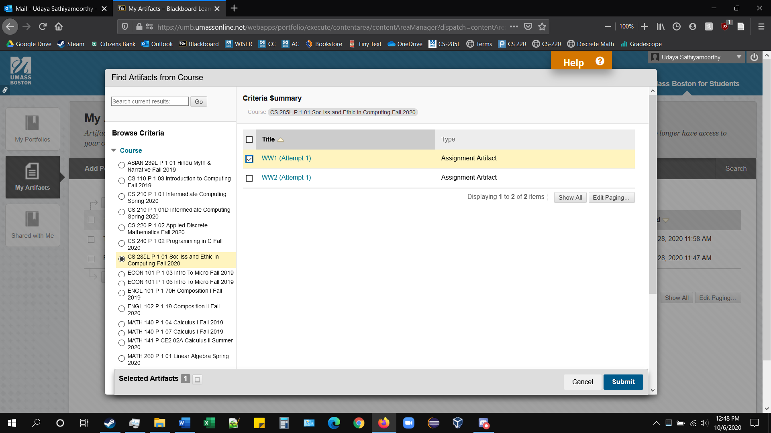
Check the box of the submission you want to add to “My Artifacts” and hit “Submit” below to add it.

Slide 13

The submission is added to your artifacts.

Slide 14
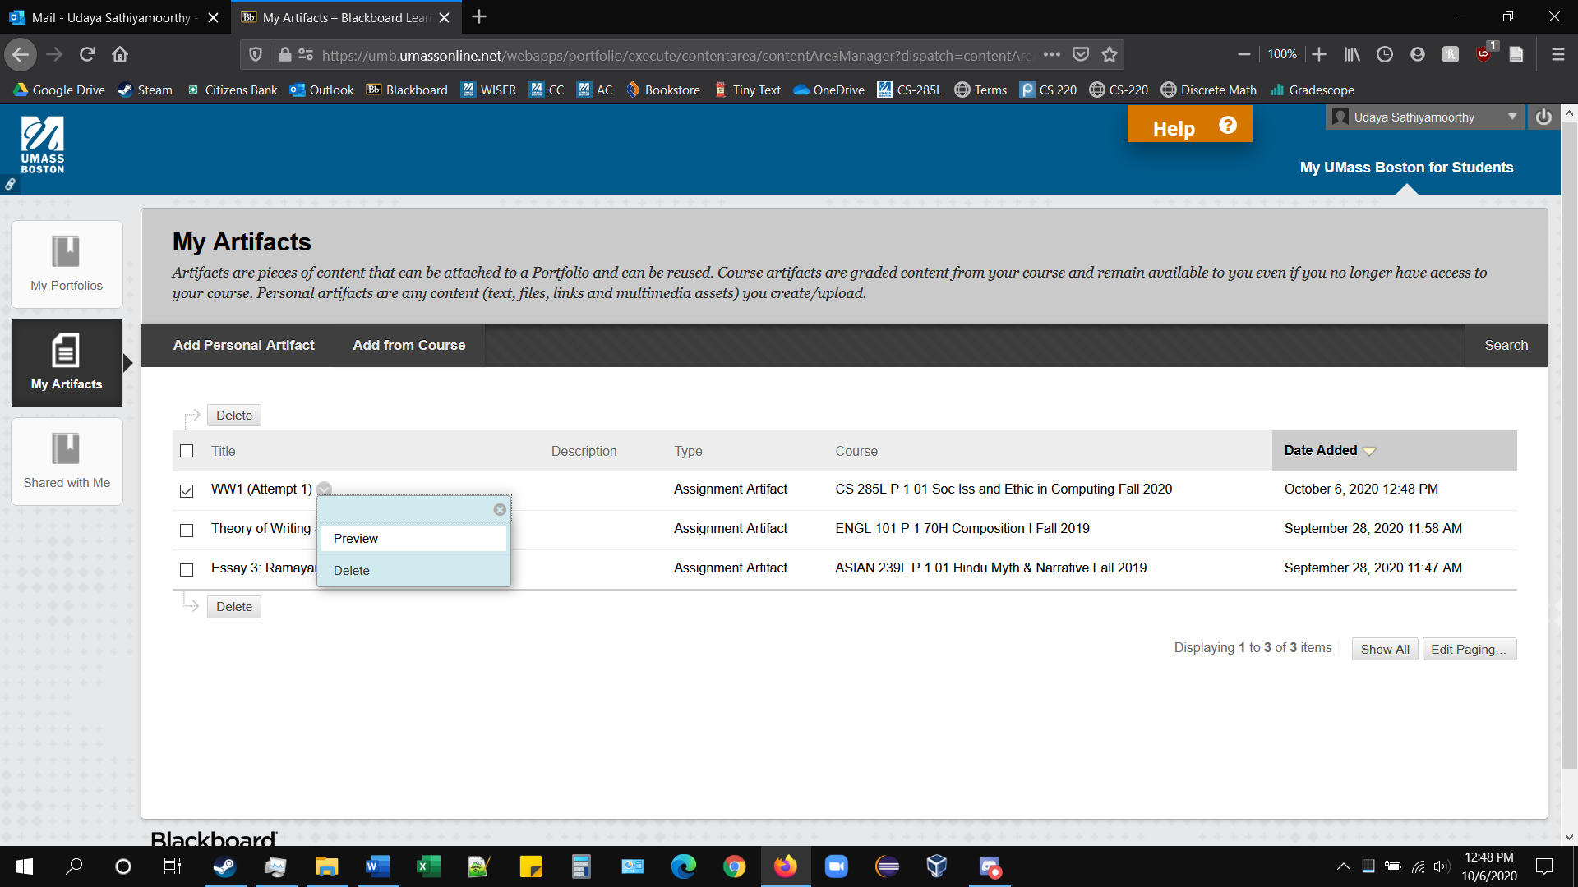
Click on the dropdown menu and select “Preview” to see the submission.

Slide 15
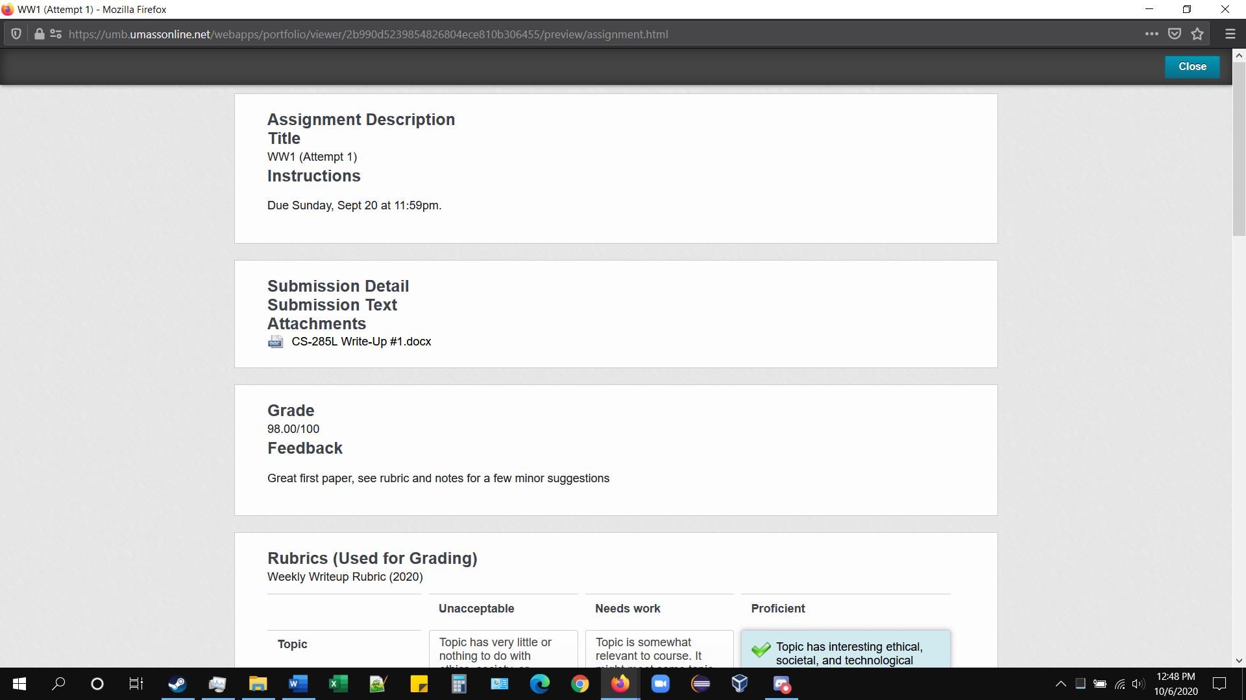
A similar window will appear, showing the assignment description, grading, and feedback.

Slide 16
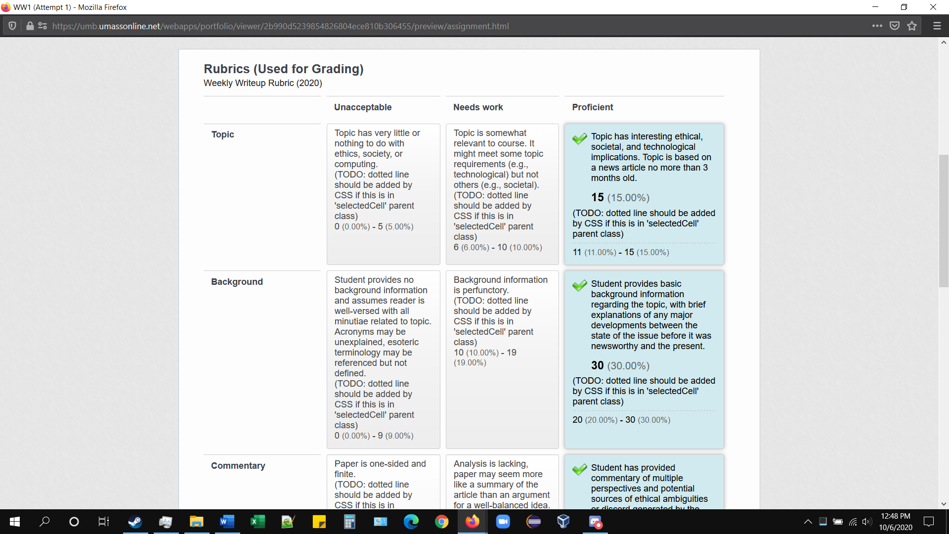
Here, you can see the rubrics used for weekly write-ups.

Slide 17
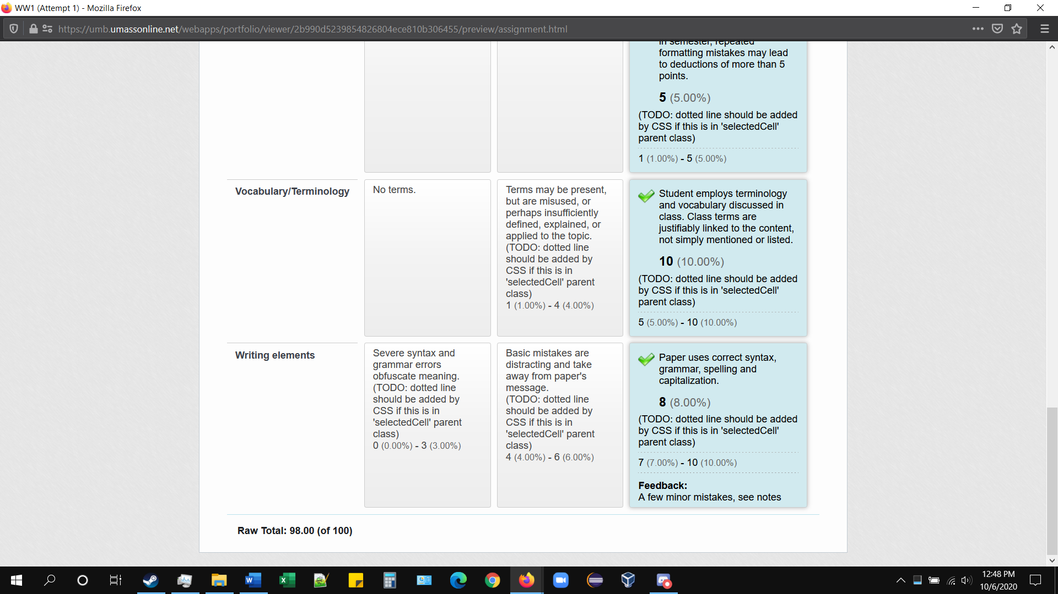

Slide 18
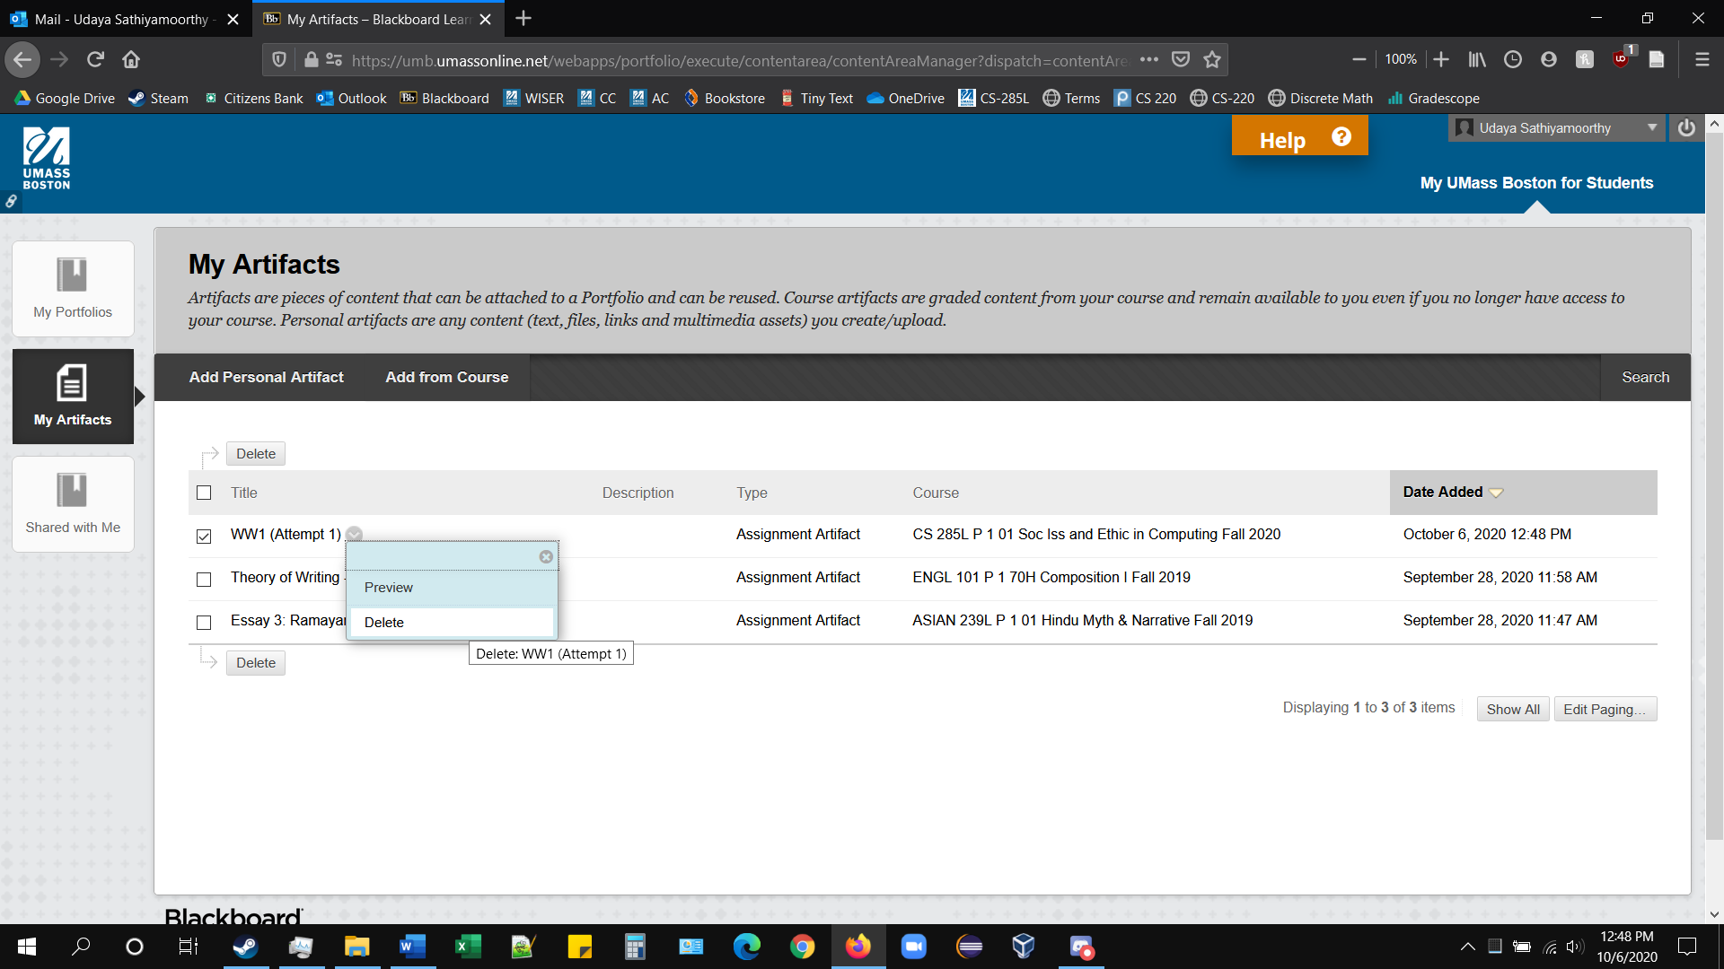
You can delete the submission from your artifacts at any time by clicking the dropdown menu and selecting “Delete.”

Slide 19
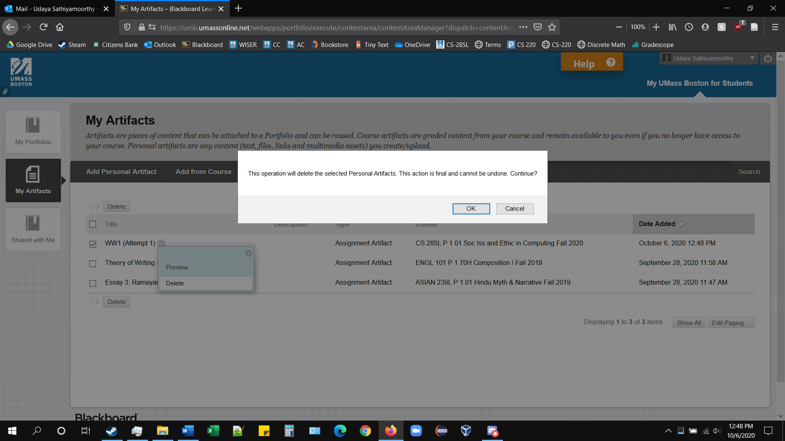
The submission will still be accessible in “Add from Course” if you ever want to add it to your artifacts again.

Slide 20
